Slide 1
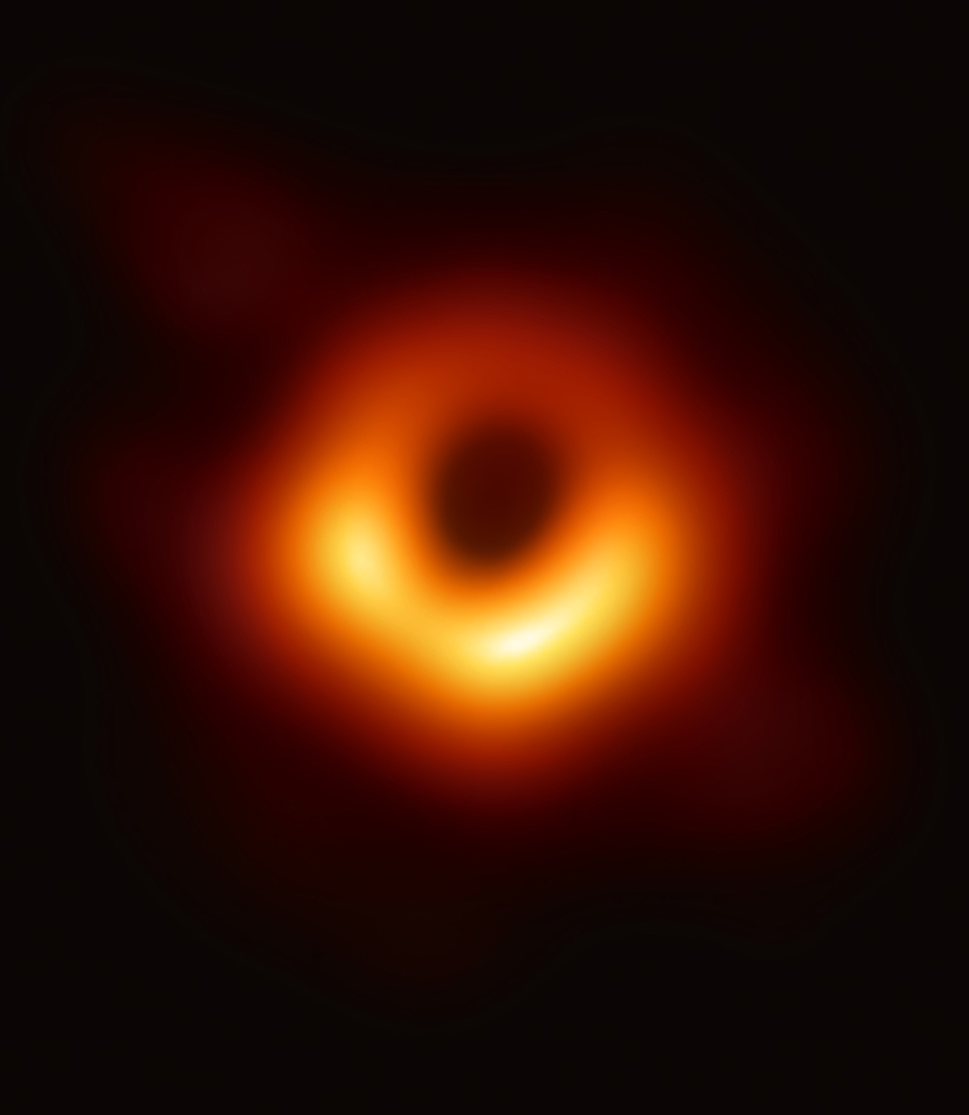
Arash Abadpour arash@abadpour.com 16 April 2019 Revision 1.07
Image courtesy of Event Horizon Telescope.
From being Seen to Seeing
A personal journey into the realm of machines that see.
Notes:
"We've now seen the unseeable," said Avery Broderick, a physicist at the University of Waterloo and the Perimeter Institute who was part of the international EHT research team. "Black holes are made real — they're not just the scribblings on theorists' chalkboards anymore, but they really are out there in the night."
https://www.cbc.ca/news/technology/event-horizon-telescope-black-hole-photographed-1.5081243

Slide 2
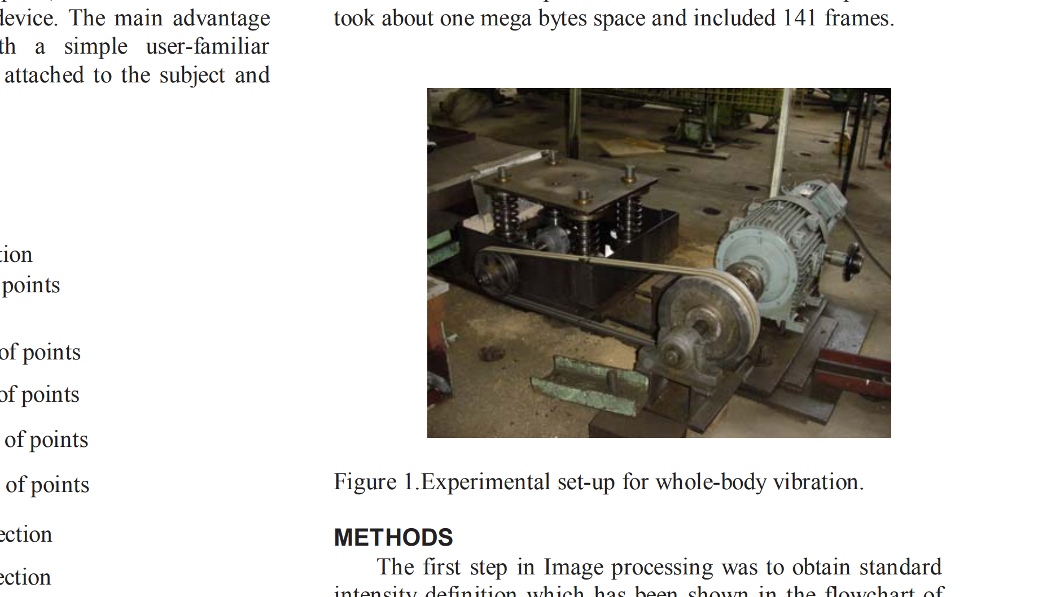
2004
R. Narimani, M. Hoviattalab, Arash Abadpour, and A. Yadollahi . “Vibration Measurement And Analysis Using Image Processing Method”, In the proceedings of the 7th Biennial Conference on Engineering Systems Design and Analysis, (ESDA), Manchester, UK, July 19-22, 2004.

Slide 3
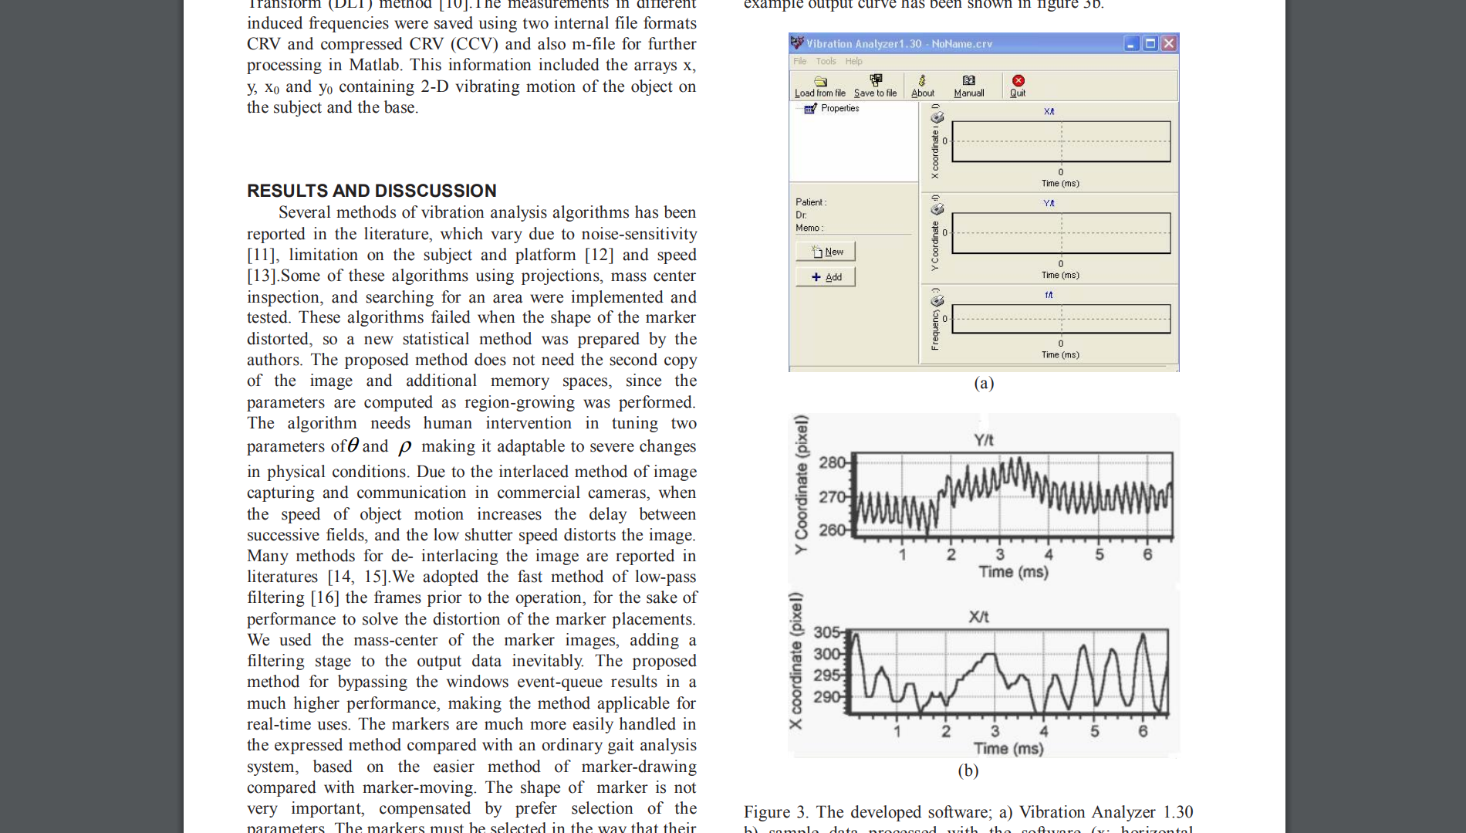
2004
R. Narimani, M. Hoviattalab, Arash Abadpour, and A. Yadollahi . “Vibration Measurement And Analysis Using Image Processing Method”, In the proceedings of the 7th Biennial Conference on Engineering Systems Design and Analysis, (ESDA), Manchester, UK, July 19-22, 2004.

Slide 4
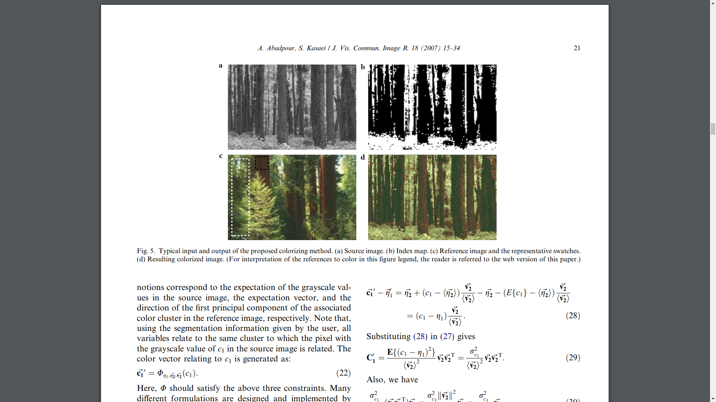
2007
Arash Abadpour and S. Kasaei. “An Efficient PCA-based Color Transfer”, Visual Communication & Image Representation, February 2007, Volume 18, Number 1, Pages, 15-34

Slide 5
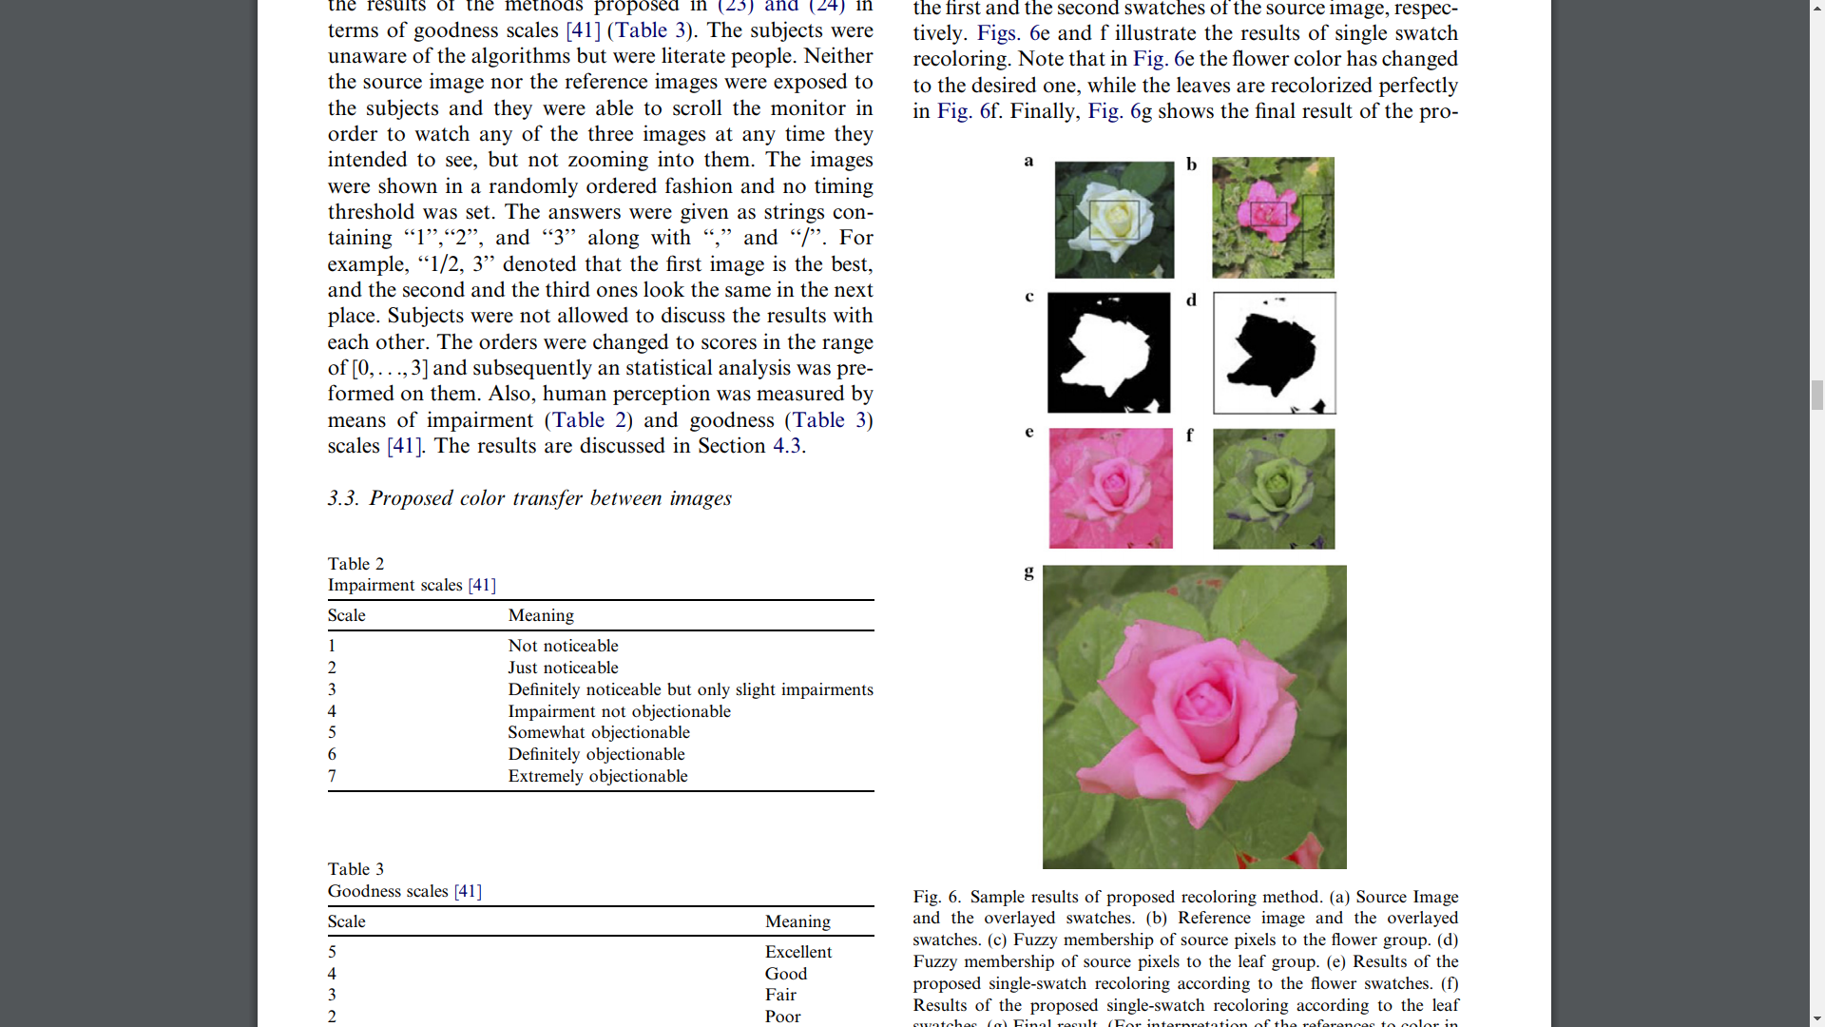
2007
Arash Abadpour and S. Kasaei. “An Efficient PCA-based Color Transfer”, Visual Communication & Image Representation, February 2007, Volume 18, Number 1, Pages, 15-34

Slide 6
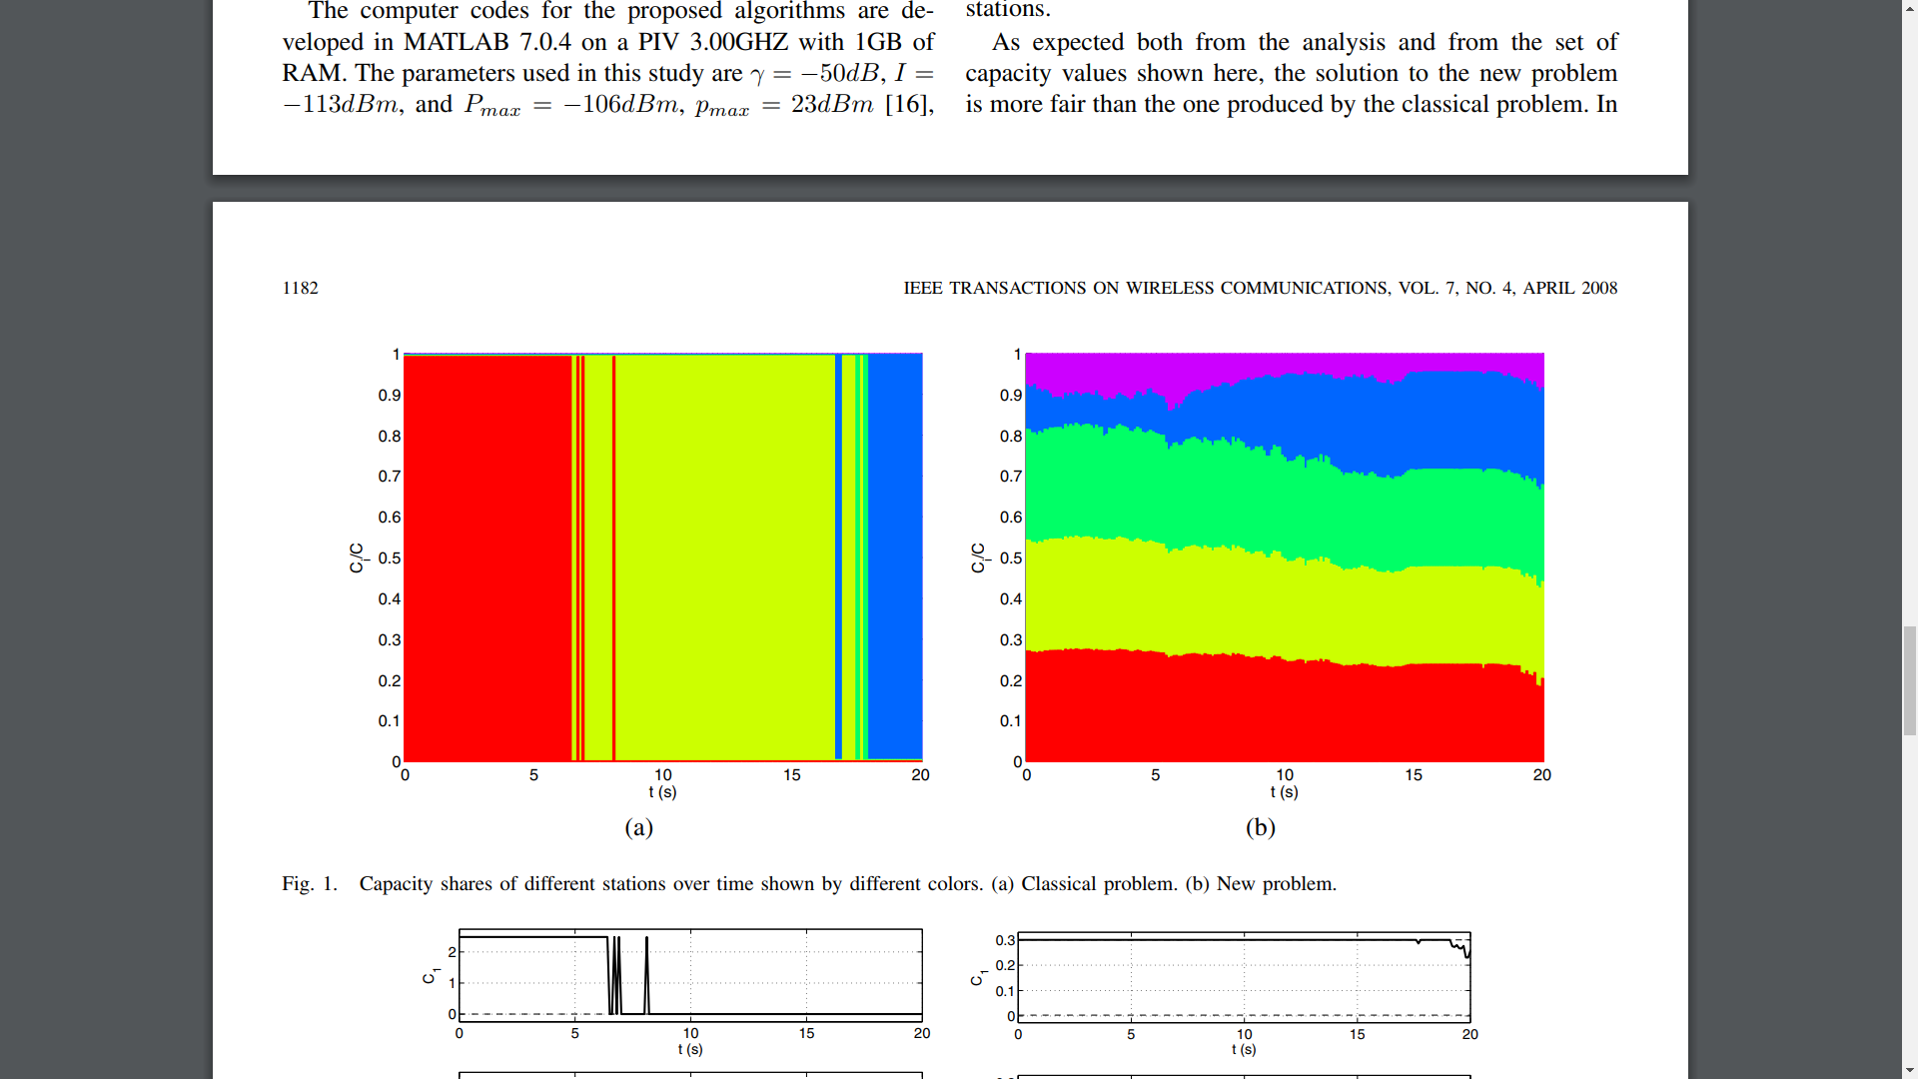
2008
Arash Abadpour, Attahiru Sule Alfa, and Anthony C.K. Soong, “Closed Form Solution for Maximizing the Sum Capacity of Reverse-Link CDMA System with Rate Constraints”, IEEE Transactions on Wireless Communications, Volume 7, Issue 4, April 2008, Page(s):1179 – 1183

Slide 7
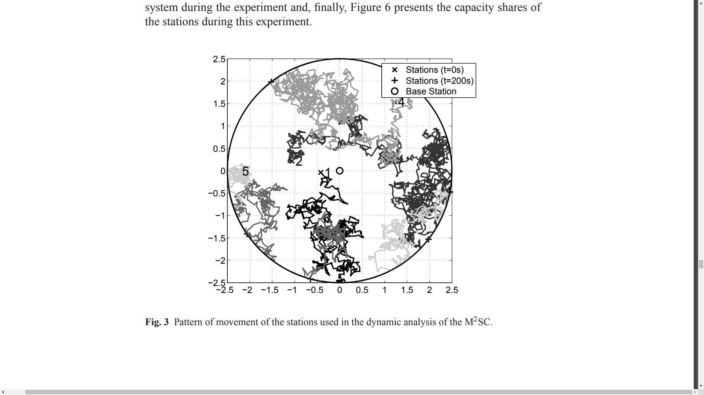
2008
Arash Abadpour and Attahiru Sule Alfa, “Approximate Algorithms for Maximizing the Capacity of the Reverse Link in Multiple-Class CDMA System”, in Operations Research and Cyber-Infrastructure, M. J. Saltzman, J. W. Chinneck, and B. Kristjansson, Editors, Springer, 2008, Pages: 237-252.

Slide 8
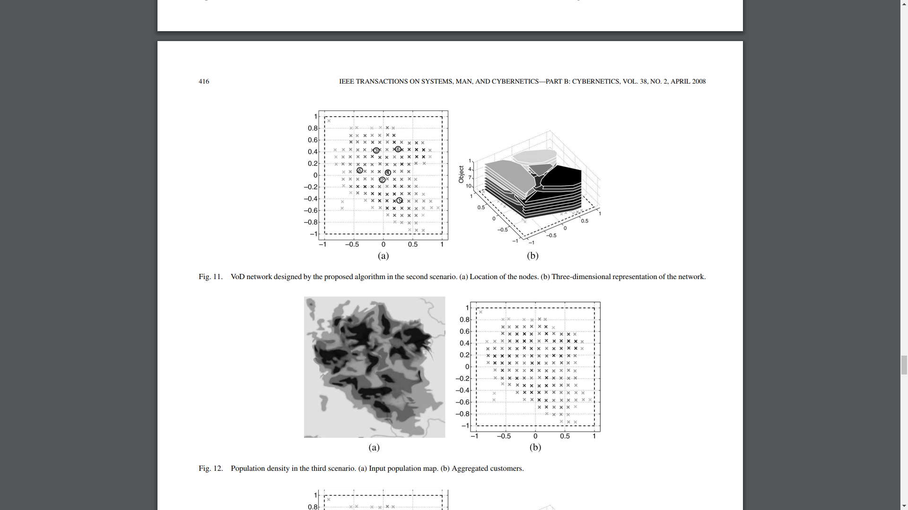
2008
Arash Abadpour, Attahiru Sule Alfa, and Jeff Diamond, “Video-on-Demand Network Design And Maintenance Using Fuzzy Optimization”, IEEE Transactions on Systems, Man, and Cybernetics, Part B, April 2008, Volume 38, Issue 2, Page:404-420

Slide 9
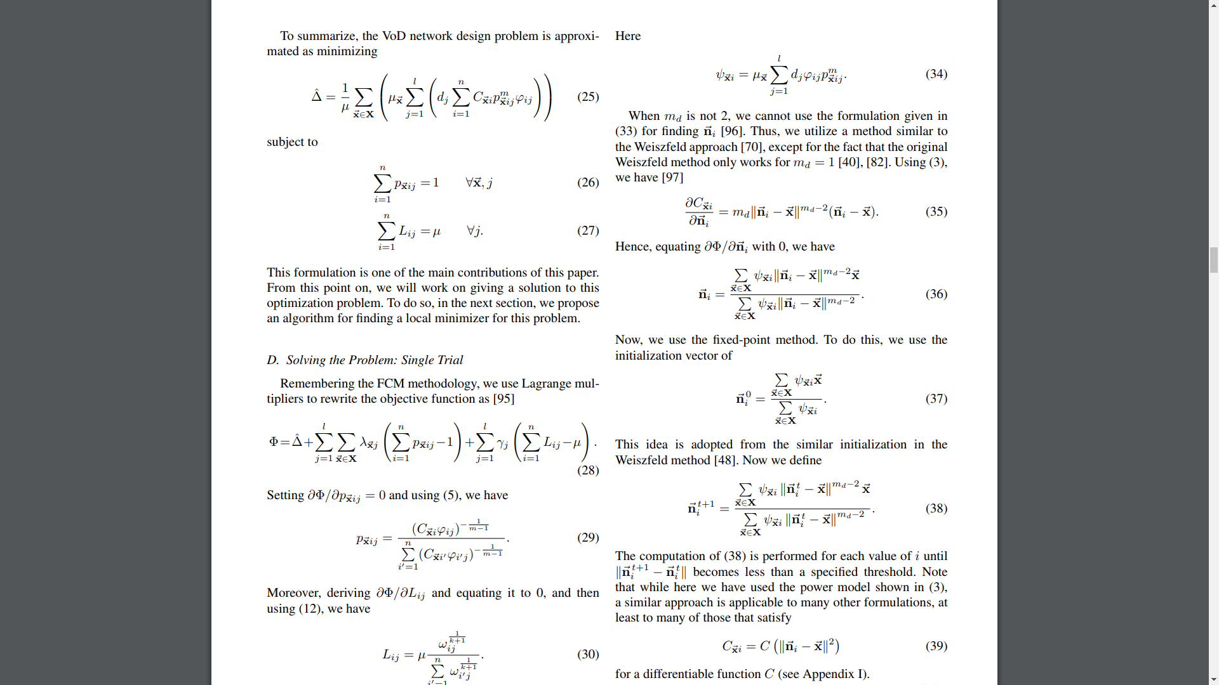
2008
Arash Abadpour, Attahiru Sule Alfa, and Jeff Diamond, “Video-on-Demand Network Design And Maintenance Using Fuzzy Optimization”, IEEE Transactions on Systems, Man, and Cybernetics, Part B, April 2008, Volume 38, Issue 2, Page:404-420

Slide 10
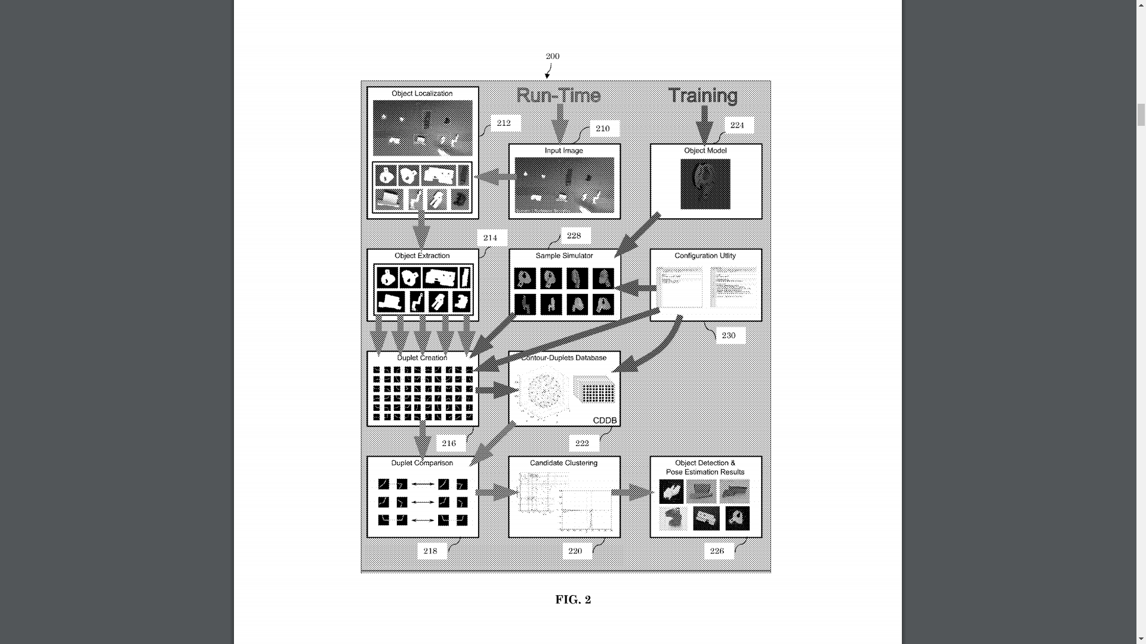
2013
Method and apparatus for object pose estimation, US Patent 8467596, Publication Date 18 June 2013

Slide 11
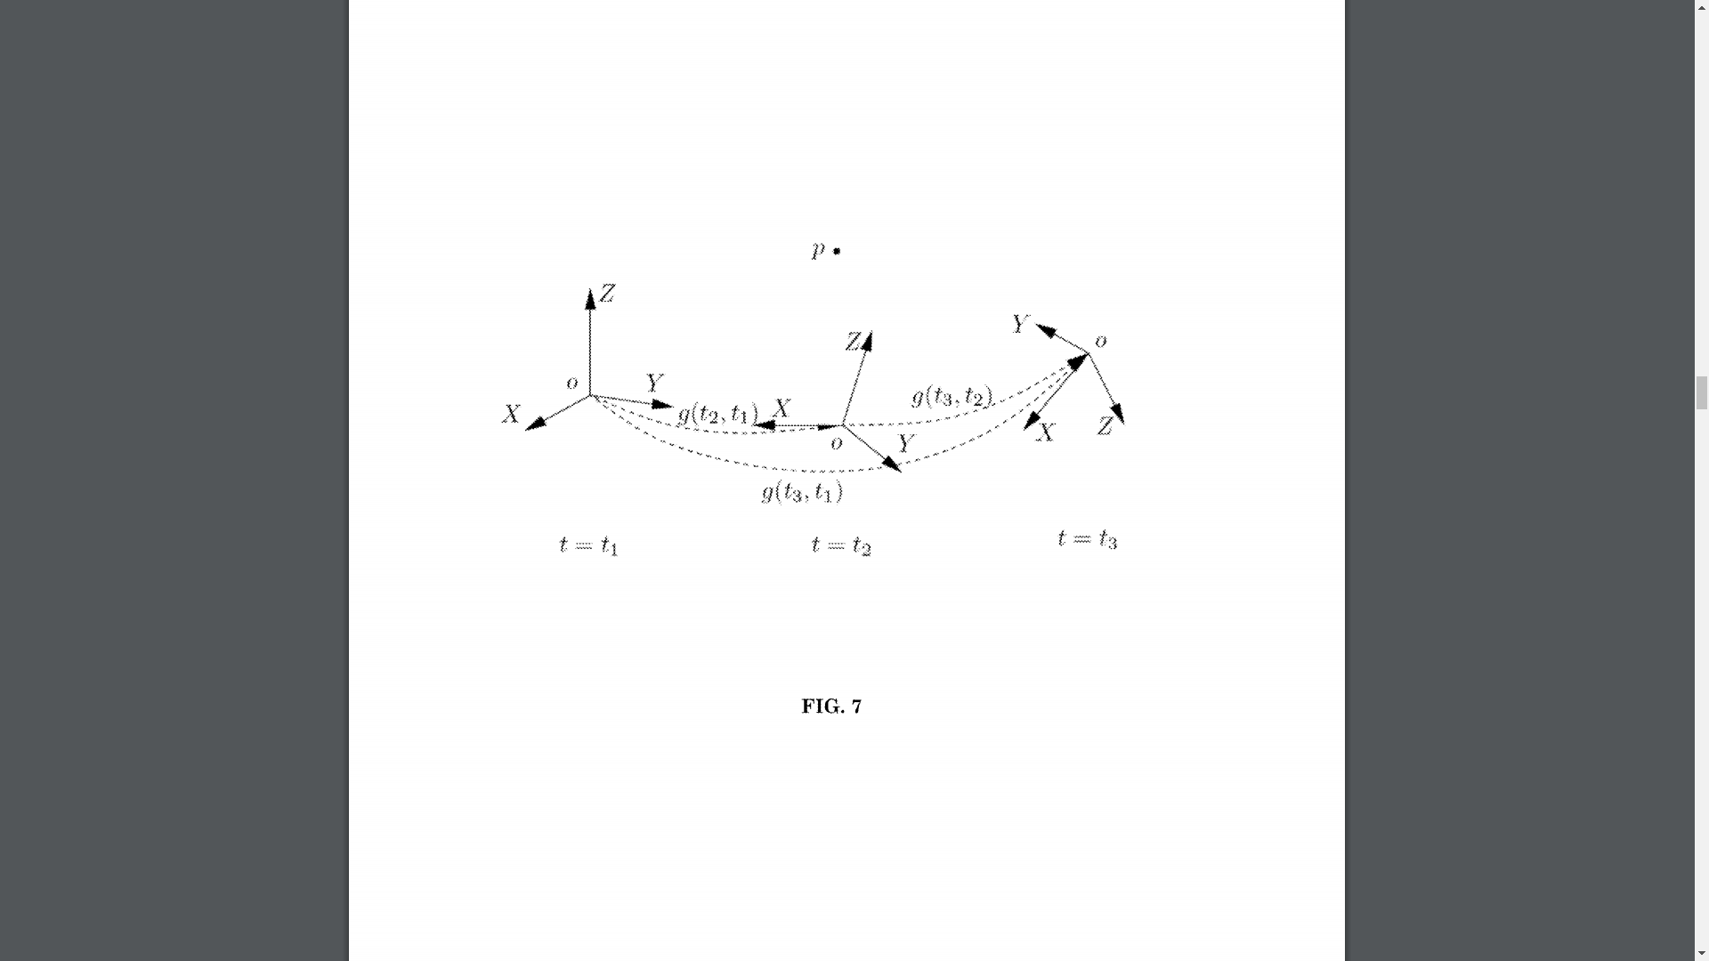
2013
Method and apparatus for object pose estimation, US Patent 8467596, Publication Date 18 June 2013

Slide 12
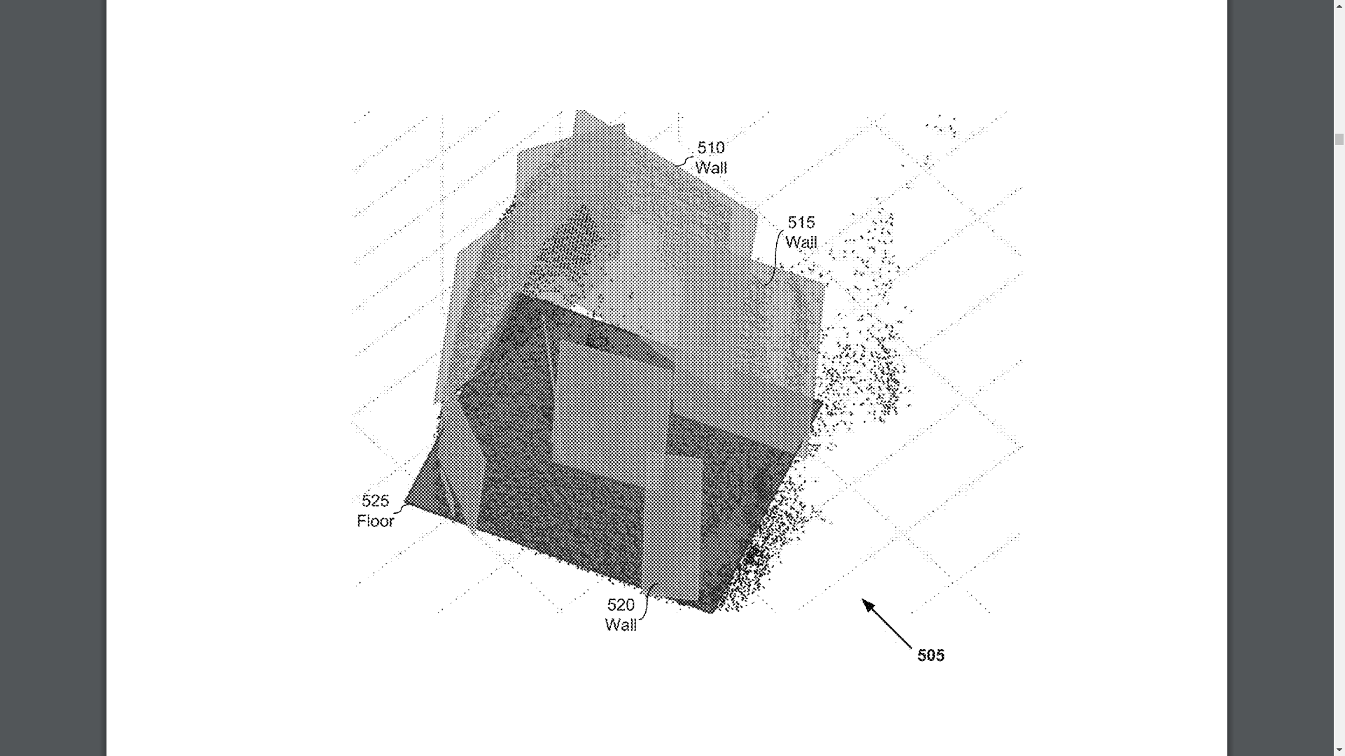
2015
Holocam Systems and Methods, US Patent US20150261184, Publication Date 17 September 2015

Slide 13
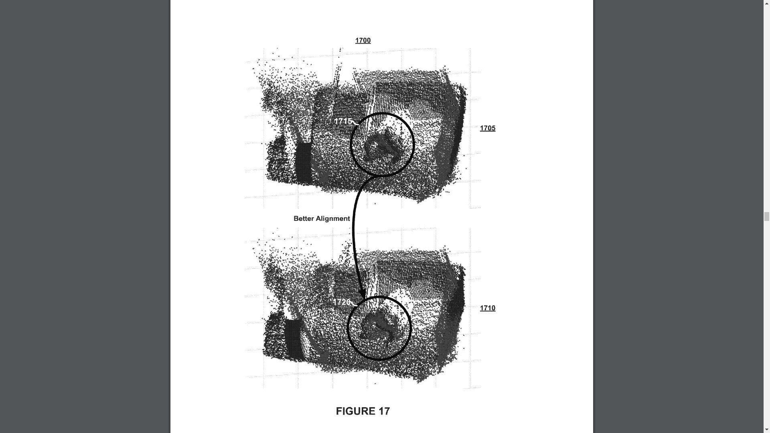
2015
Holocam Systems and Methods, US Patent US20150261184, Publication Date 17 September 2015

Slide 14
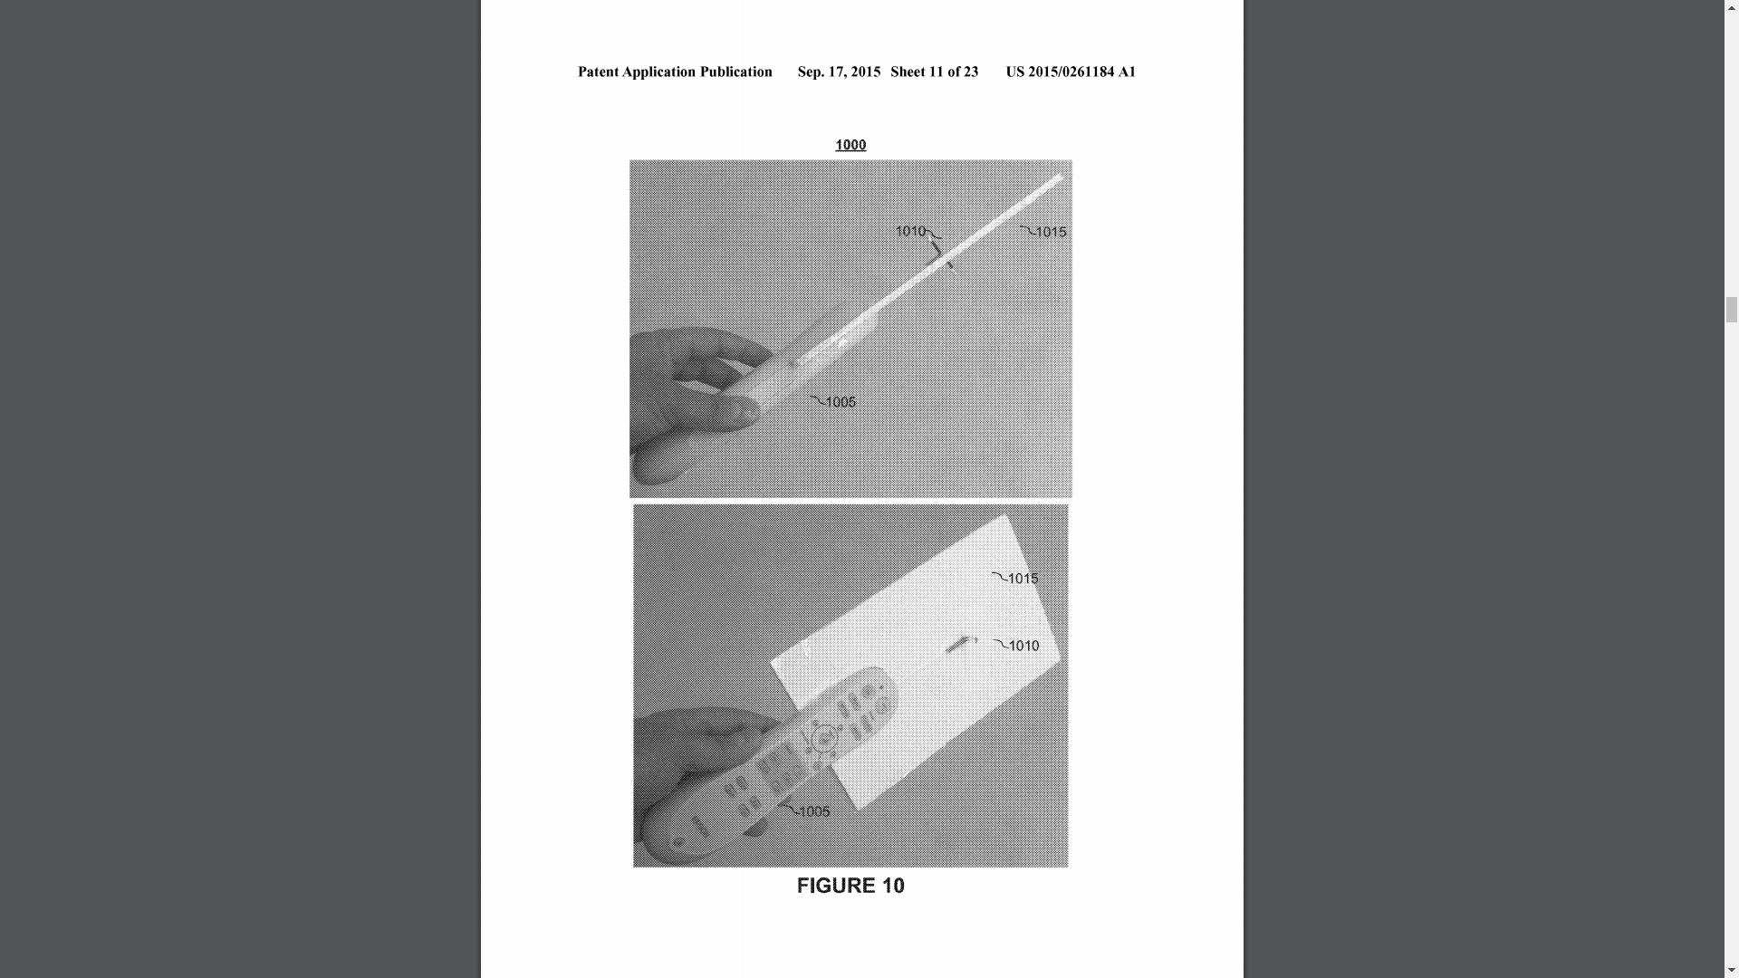
2015
Holocam Systems and Methods, US Patent US20150261184, Publication Date 17 September 2015

Slide 15
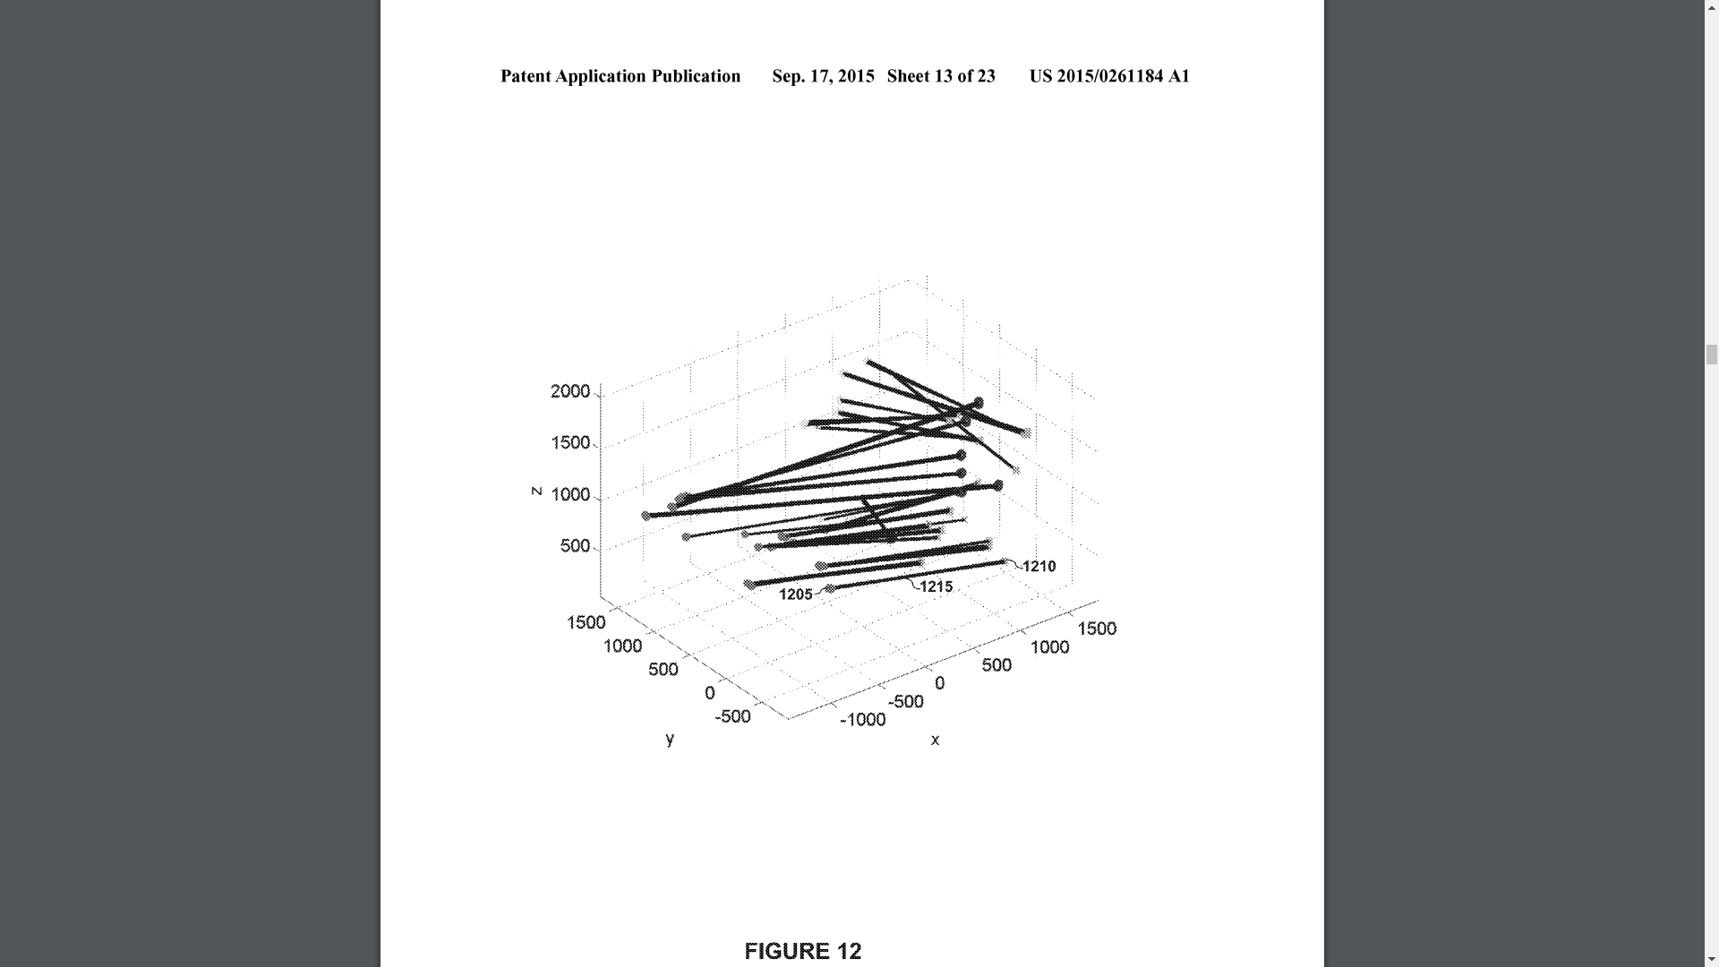
2015
Holocam Systems and Methods, US Patent US20150261184, Publication Date 17 September 2015

Slide 16
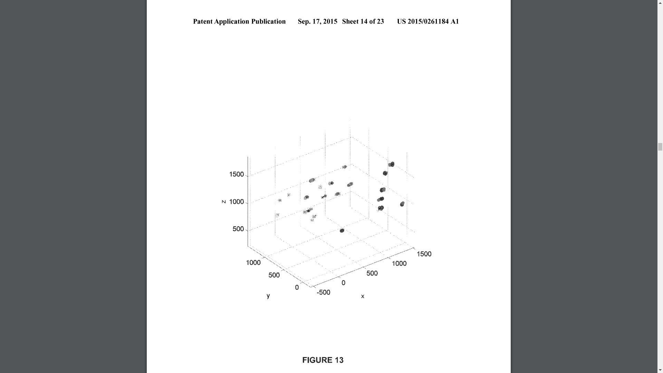
2015
Holocam Systems and Methods, US Patent US20150261184, Publication Date 17 September 2015

Slide 17
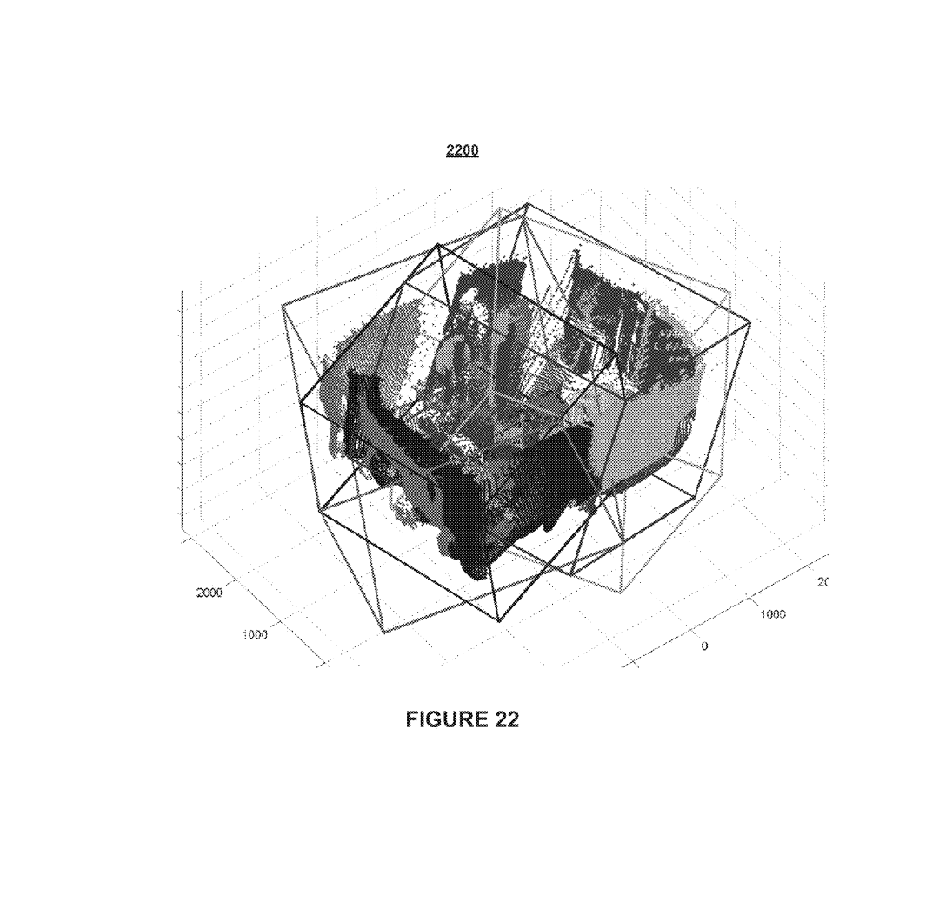
2015
Holocam Systems and Methods, US Patent US20150261184, Publication Date 17 September 2015

Slide 18
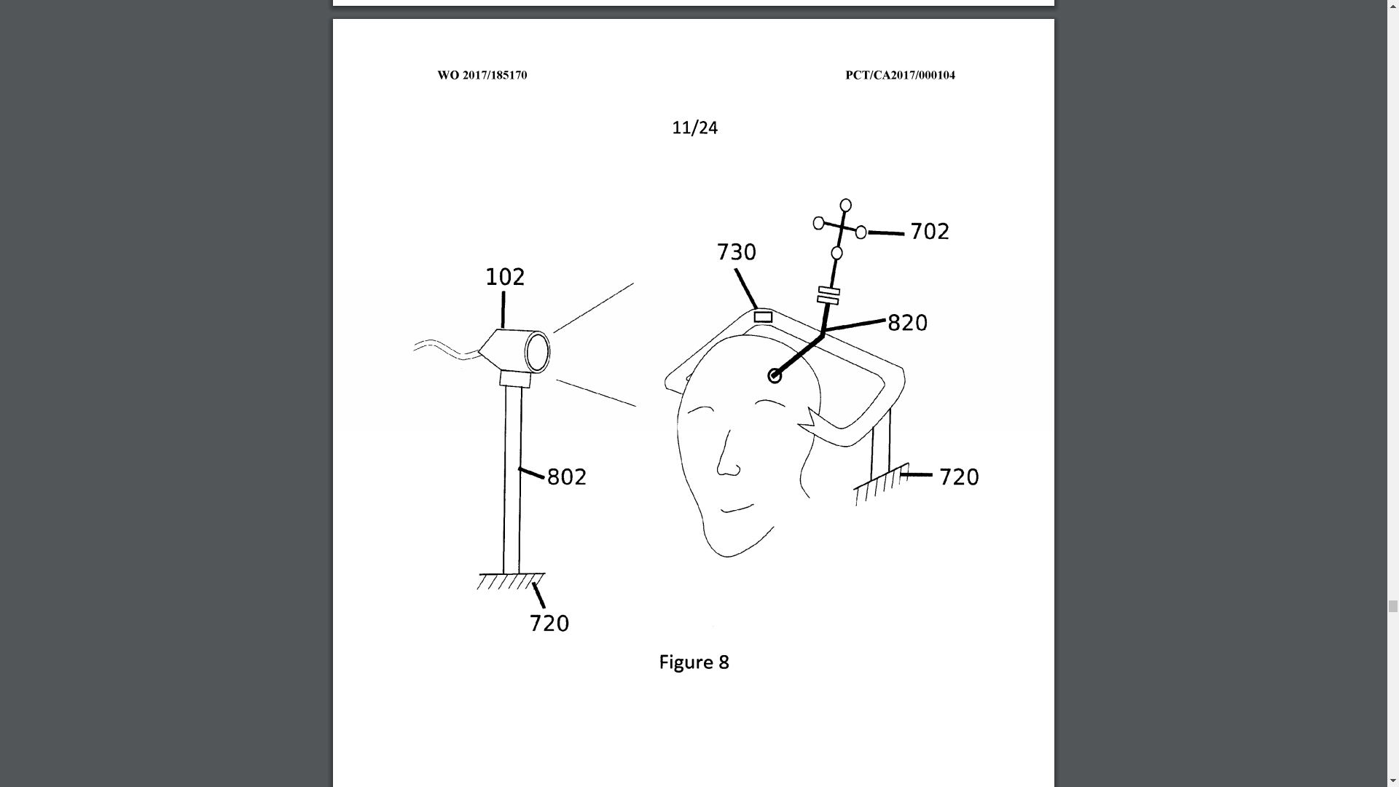
2016
Systems, methods and devices to scan 3d surfaces for intra-operative localization, International Publication Number WO2017185170A1, Priority Date 28 April 2016

Slide 19
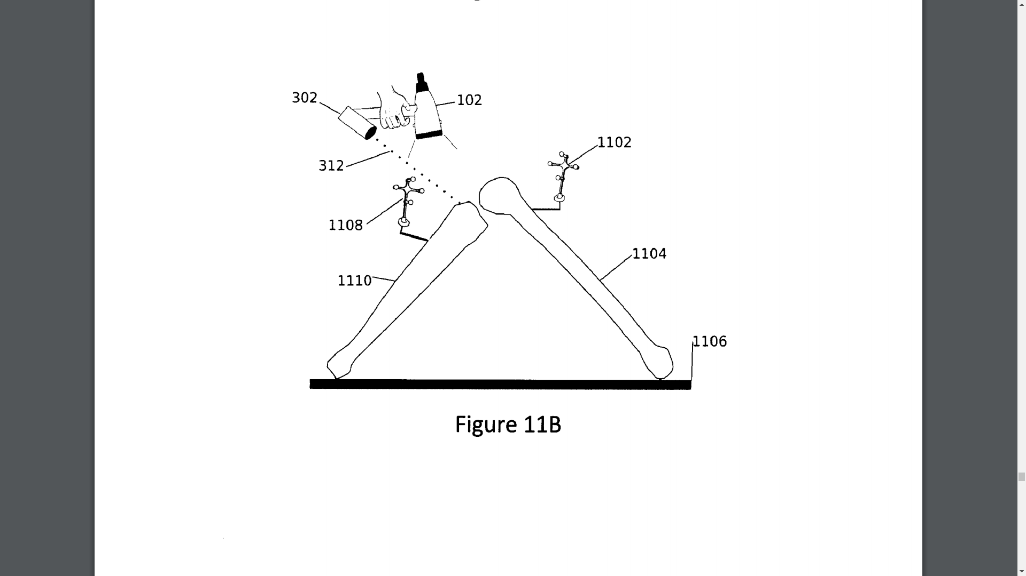
2016
Systems, methods and devices to scan 3d surfaces for intra-operative localization, International Publication Number WO2017185170A1, Priority Date 28 April 2016

Slide 20
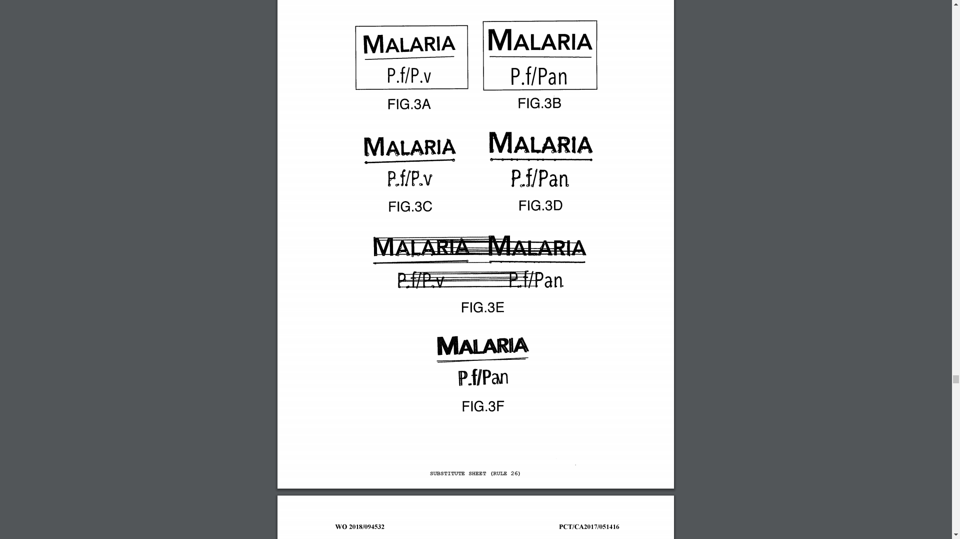
2016
Visual pattern recognition system, method and/or computer-readable medium, WO Application Number WO2018094532A1, Priority Date 26 November 2016

Slide 21
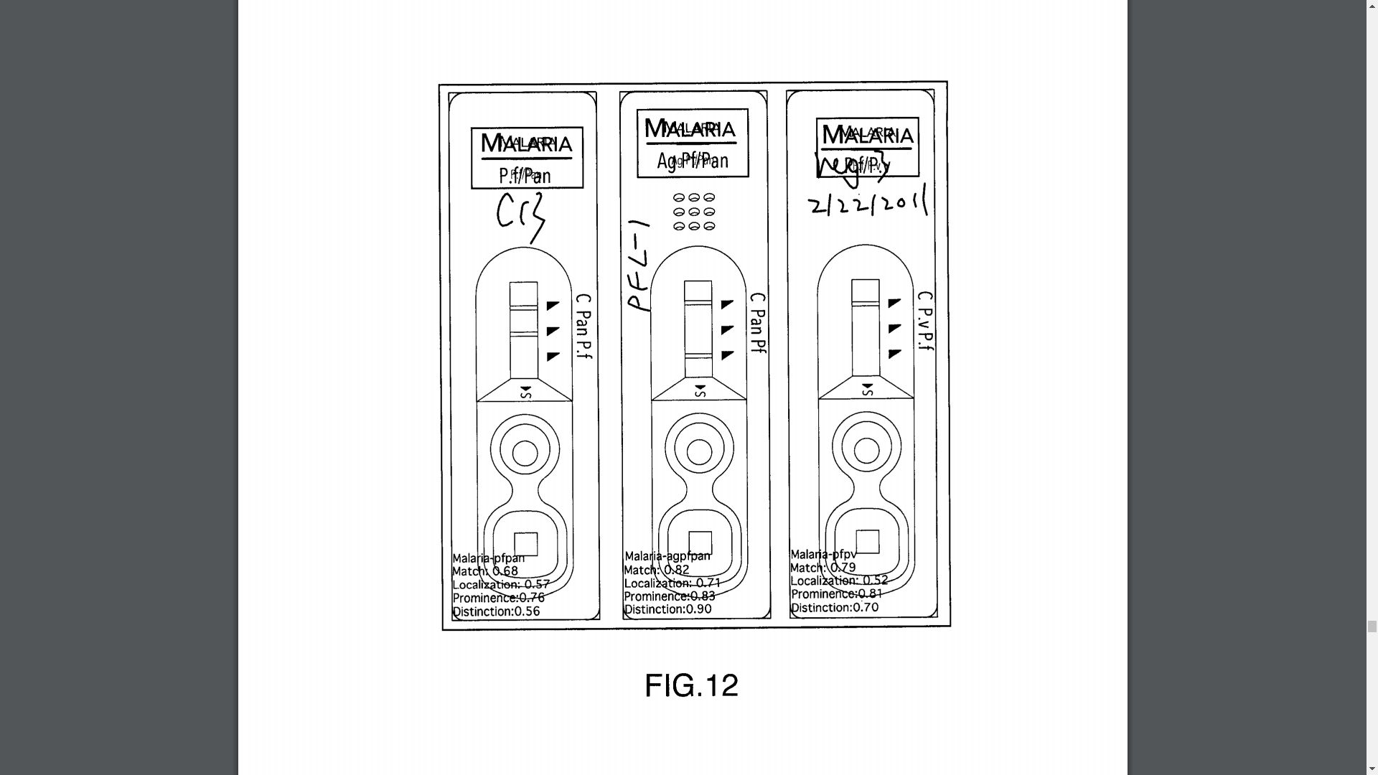
2016
Visual pattern recognition system, method and/or computer-readable medium, WO Application Number WO2018094532A1, Priority Date 26 November 2016

Slide 22
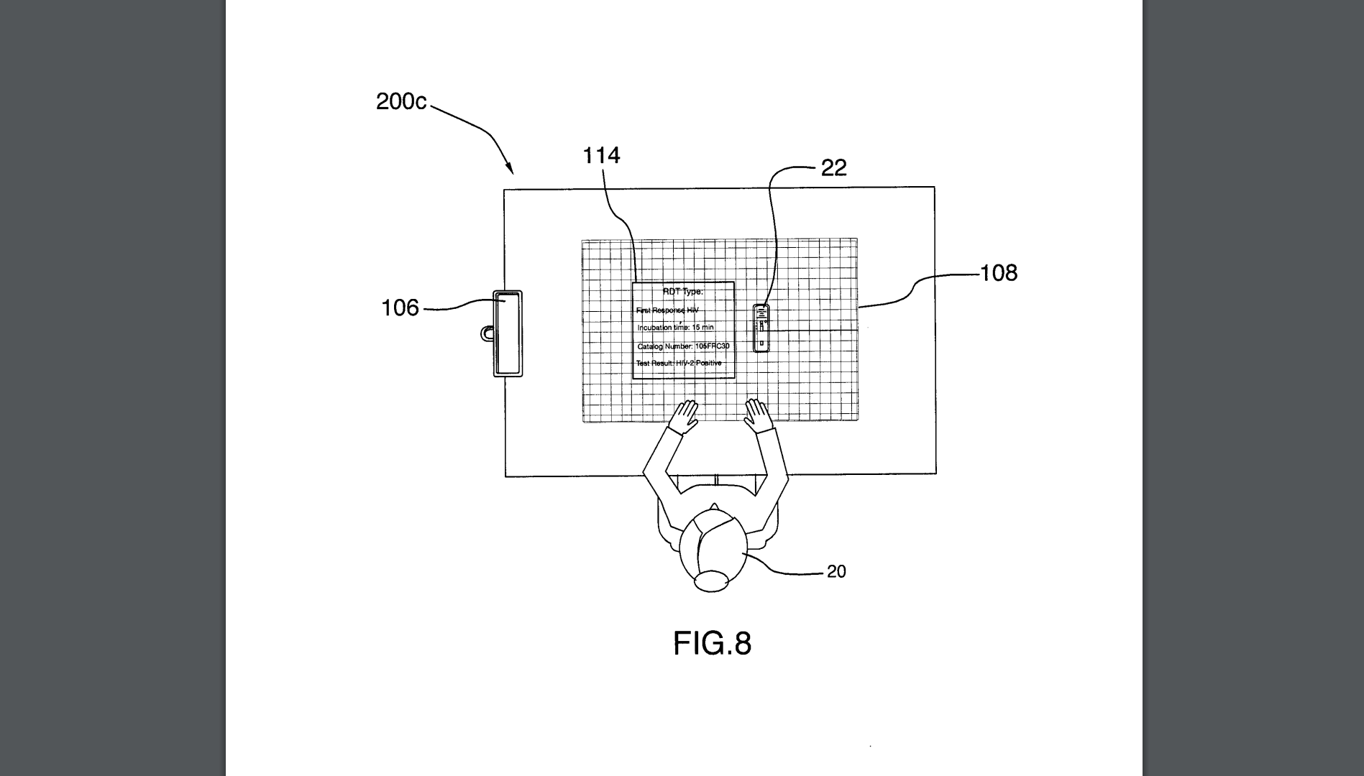
2016
System, method and/or computer readable medium for non-invasive workflow augmentation, WO Application Number WO2018094534A1, Priority Date 26 November 2016

Slide 23
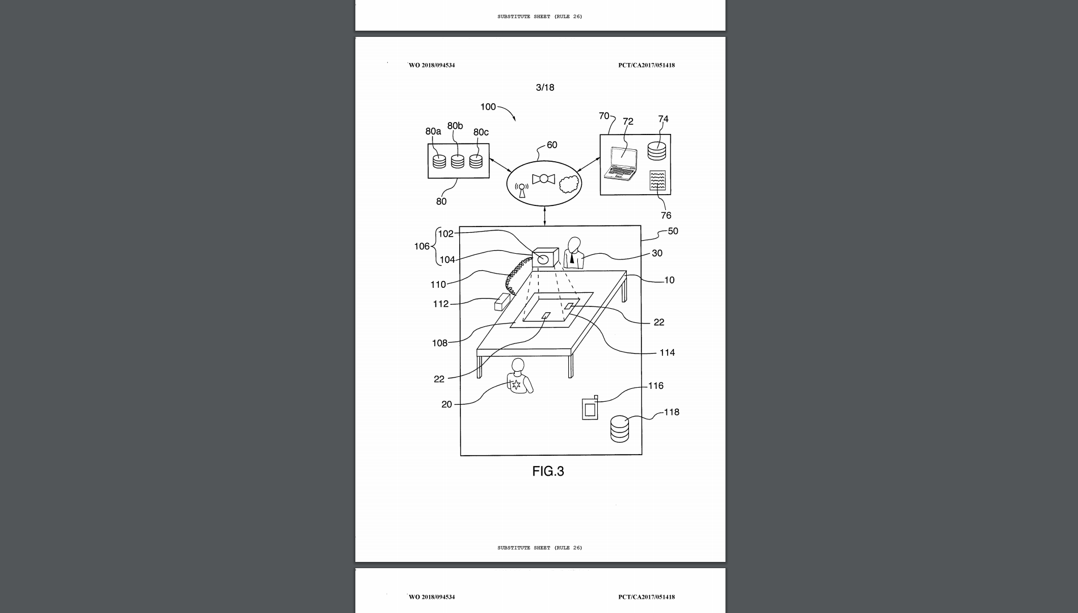
2016
System, method and/or computer readable medium for non-invasive workflow augmentation, WO Application Number WO2018094534A1, Priority Date 26 November 2016

Slide 24
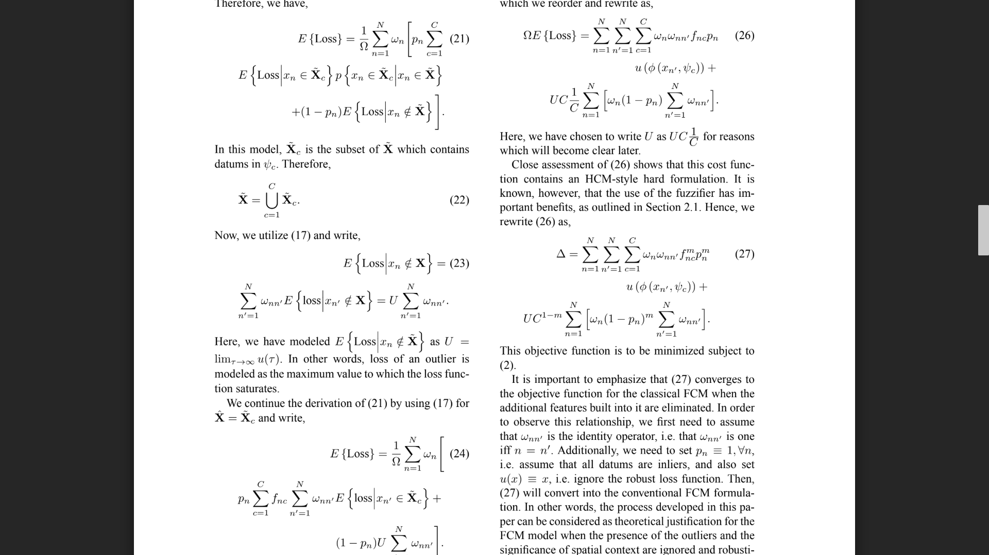
2016
Arash Abadpour, “Incorporating spatial context into fuzzy-possibilistic clustering using Bayesian inference”, Journal of Intelligent and Fuzzy Systems, Volume 30, No. 2, February 2016, Pages 895-919

Slide 25
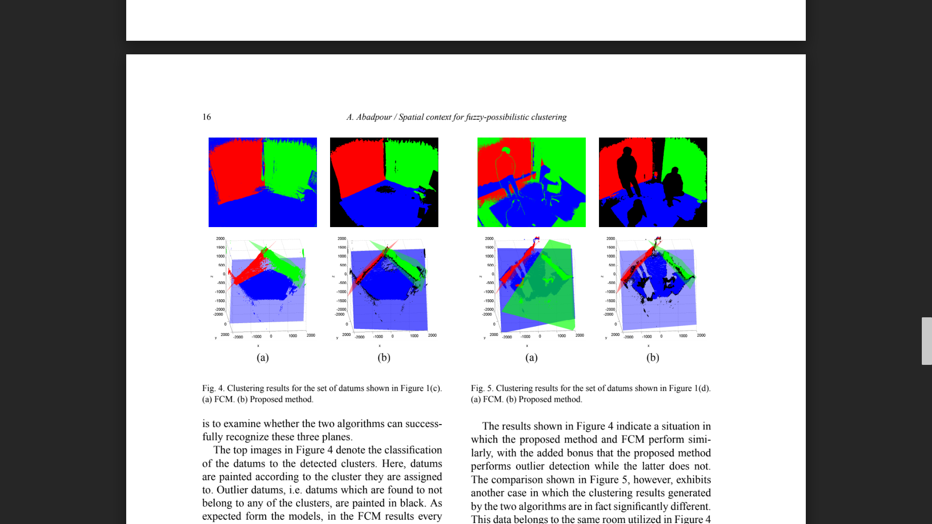
2016
Arash Abadpour, “Incorporating spatial context into fuzzy-possibilistic clustering using Bayesian inference”, Journal of Intelligent and Fuzzy Systems, Volume 30, No. 2, February 2016, Pages 895-919

Slide 26
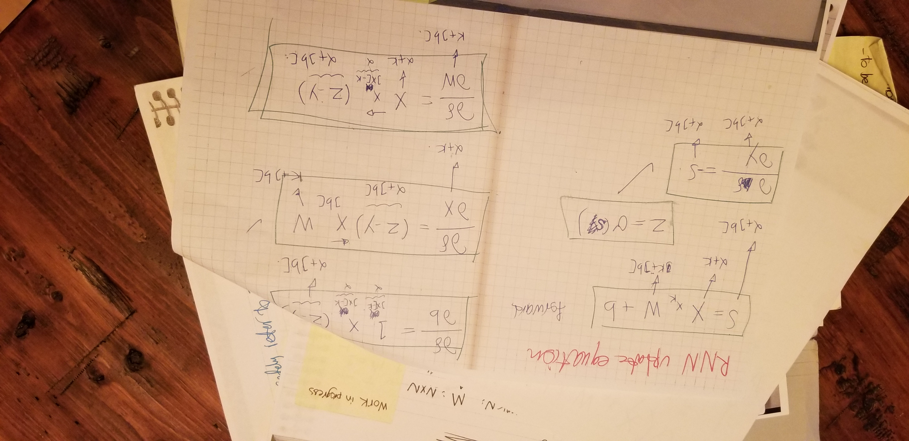
2019
Reflective Nuclear Network (RNN)

Slide 27
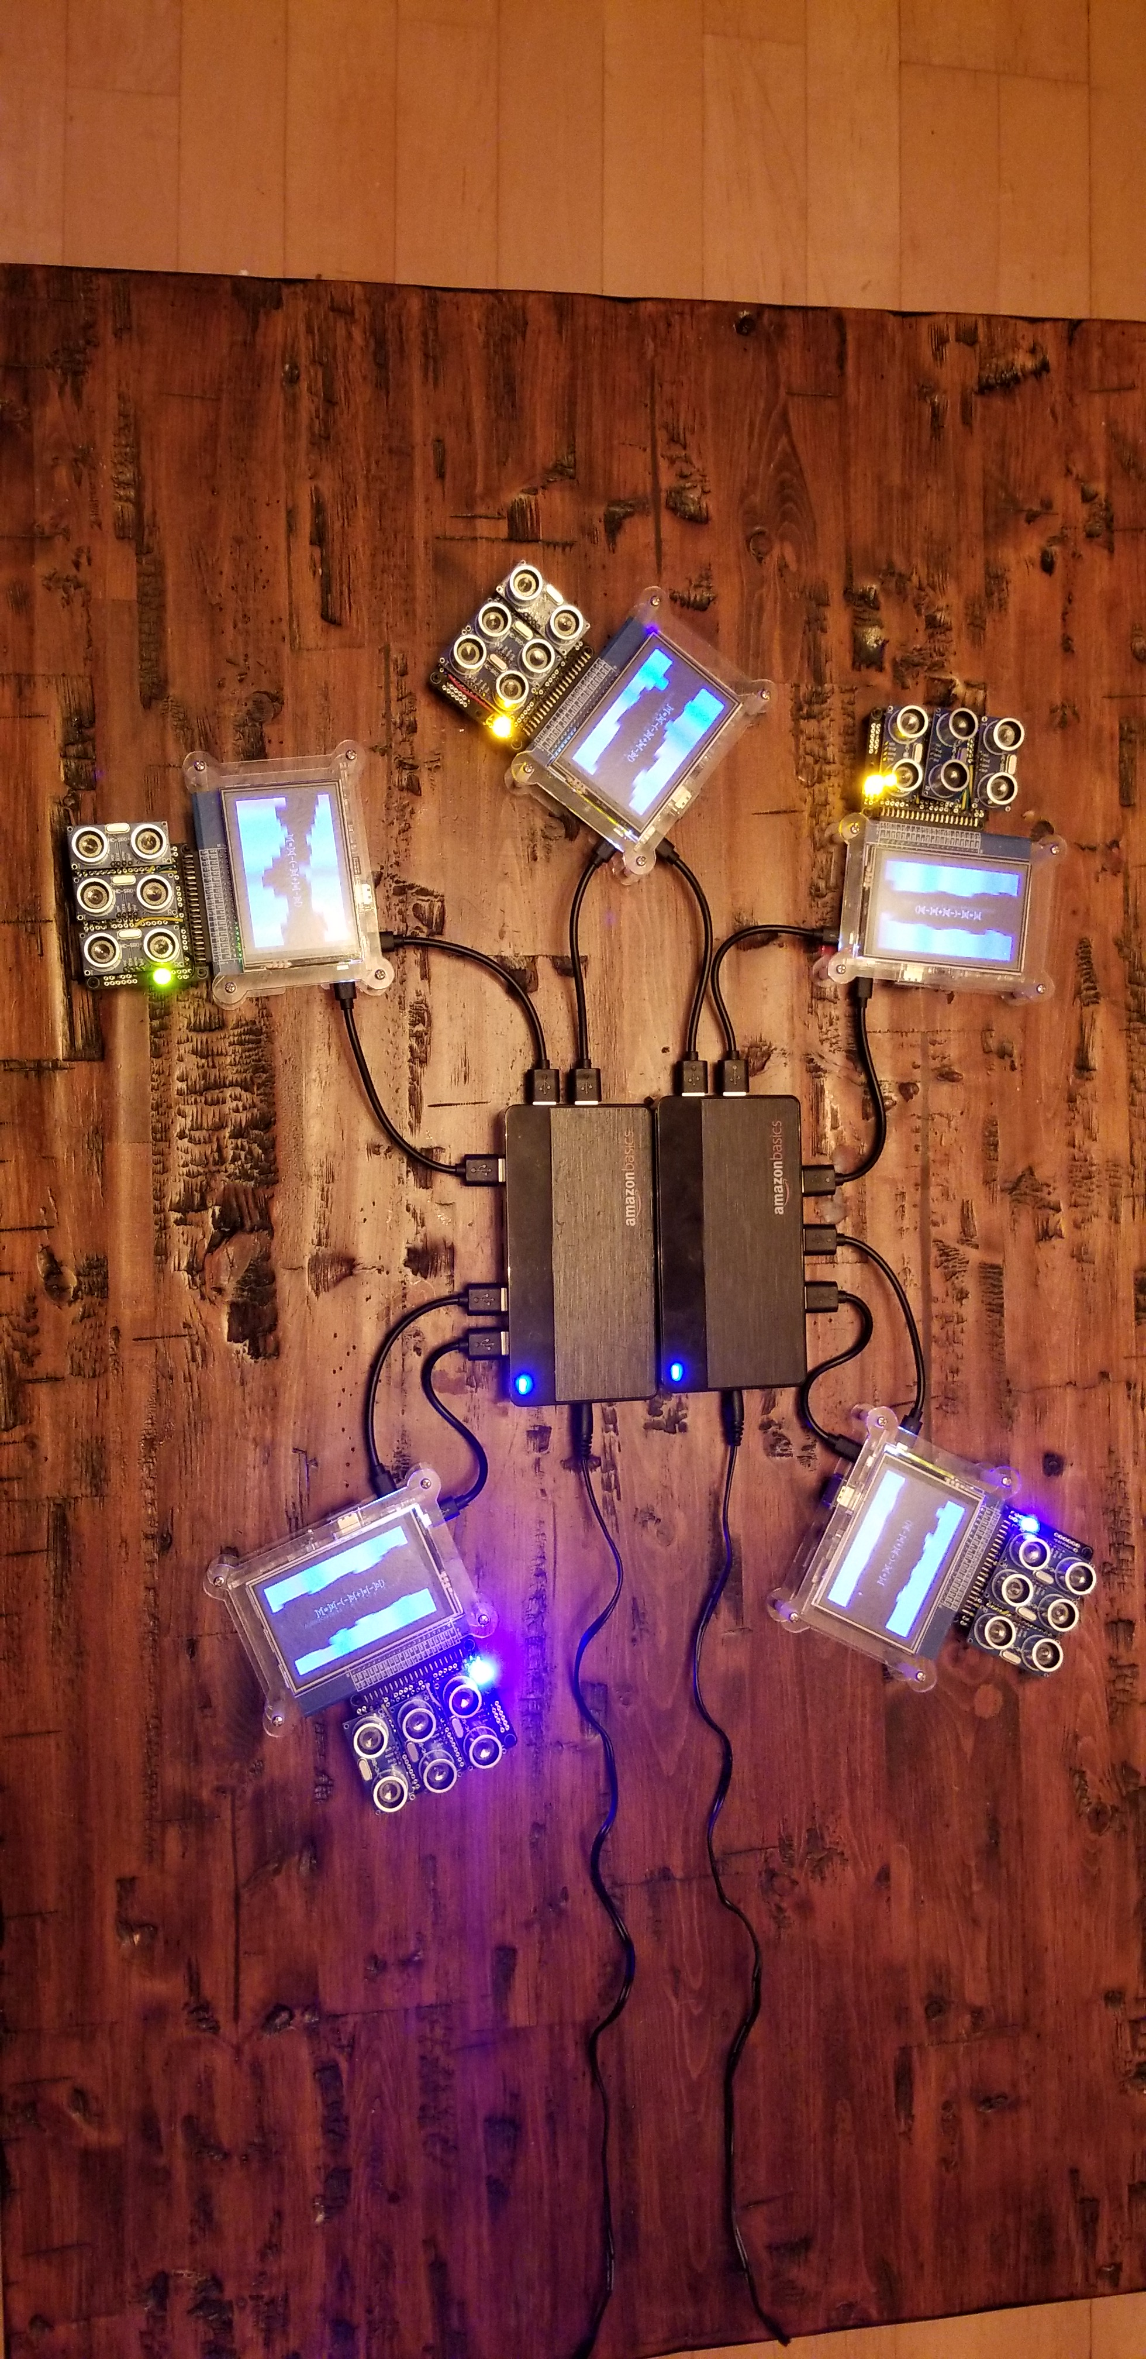
2019
Reflective Nuclear Network (RNN)

Slide 28
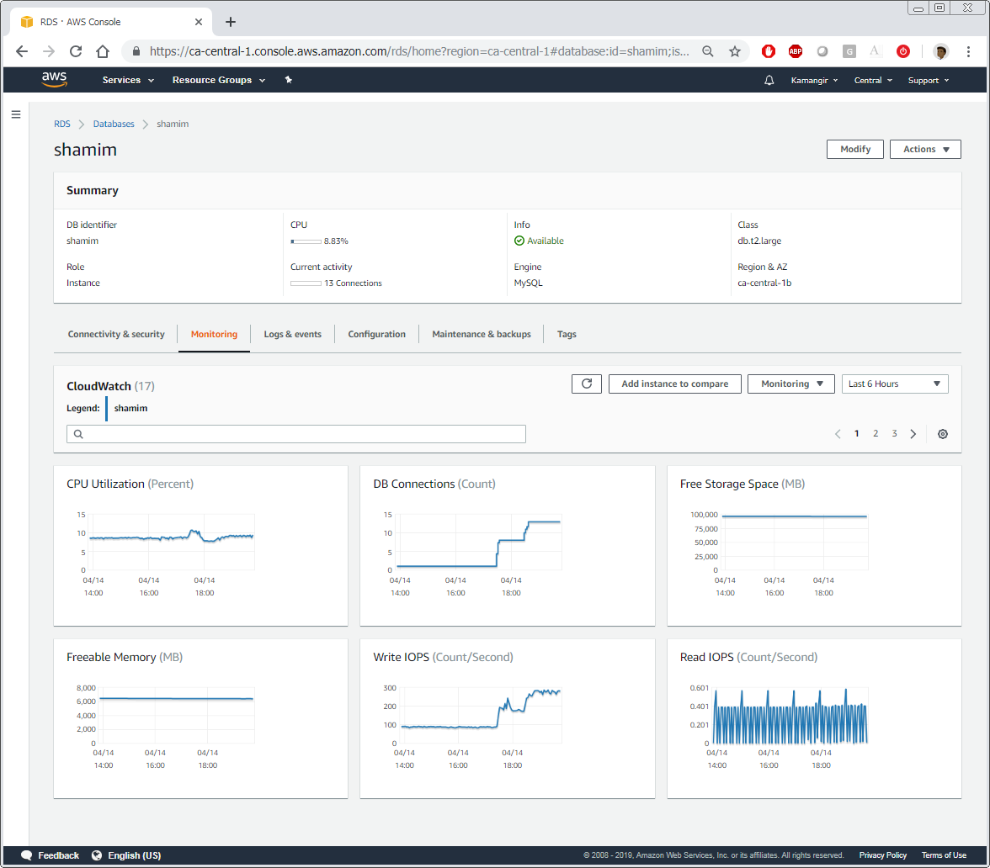
2019
Reflective Nuclear Network (RNN)

Slide 29
THE END

Slide 30
THE END
Beginning
Thank you very much for your attention.
Any comments/questions/ideas?

